Slide 1
ArcGIS Enterprise Monitoring Dashboard
(or how to see a bit of what's going on under the hood)

Slide 2


A bit about me
Keith Miller
GIS Manager at Kāpiti Coast District Council

Slide 3
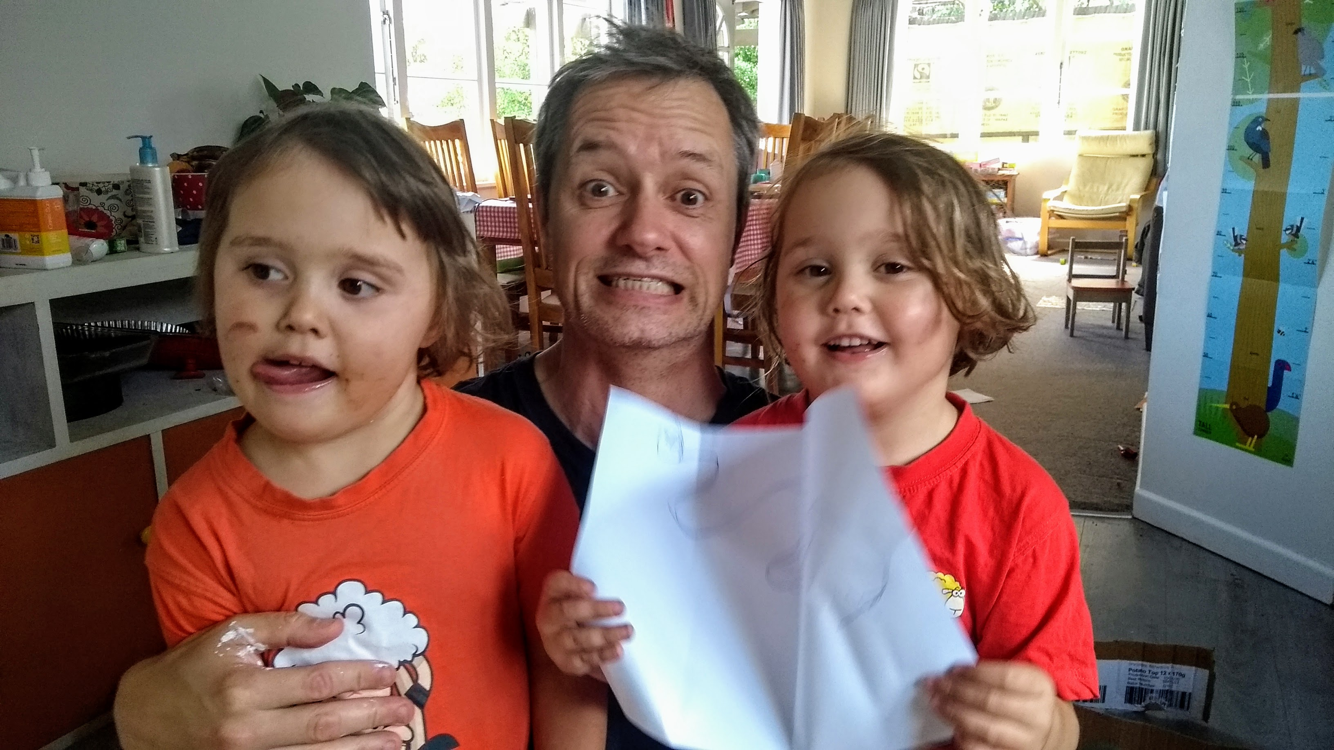
A bit about me
Keith Miller
GIS Manager at Kāpiti Coast District Council

Slide 4
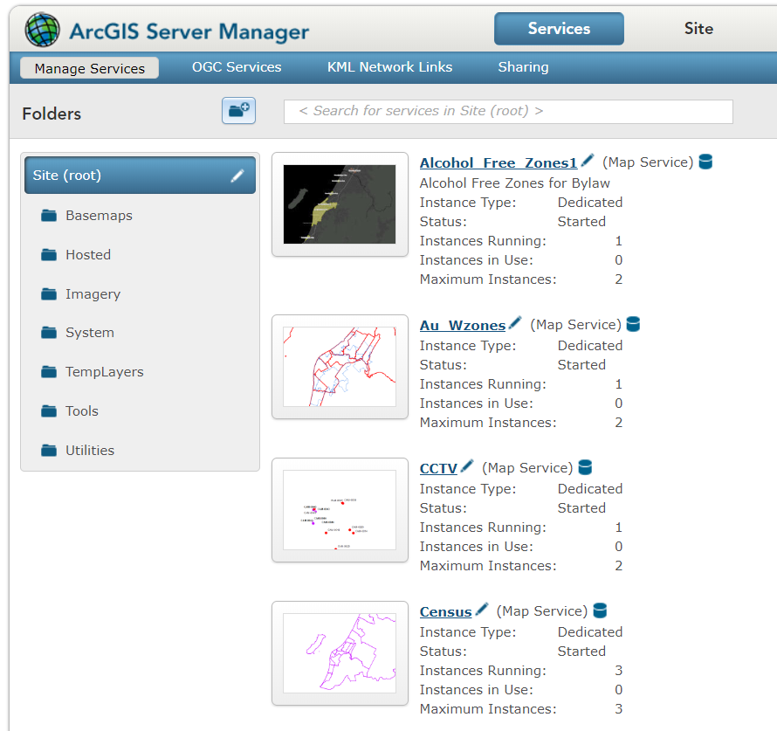
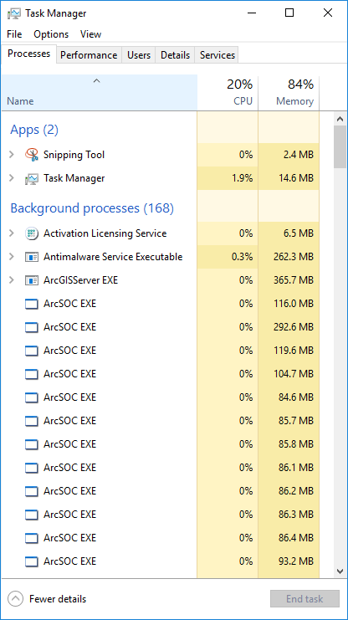
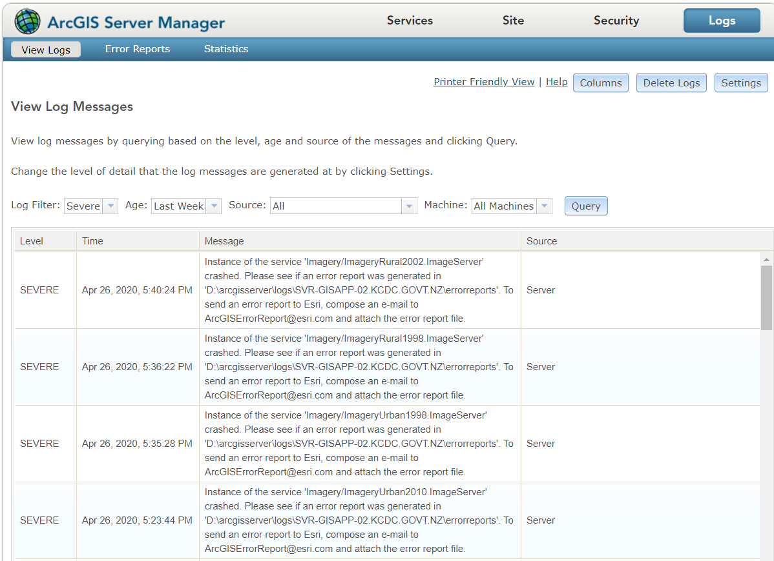
ArcGIS Enterprise Questions
What is the current load on the server? (how many layers are being requested)
Are all services up and running?
Which layers take a long time to draw?
Have any errors / warnings occurred recently?

Slide 5
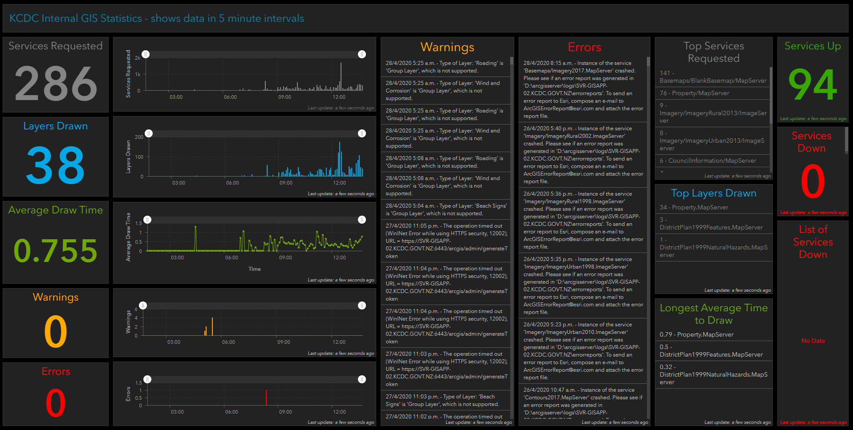
The Dashboard (ideally wall-mounted)
Keith Miller
GIS Manager at Kāpiti Coast District Council

Slide 6
Technology Used
ArcGIS Dashboard
Python
ArcGIS Python API
Feature Services / Classes / Layers
Windows scheduled tasks
Windows batch files
Email

Slide 7
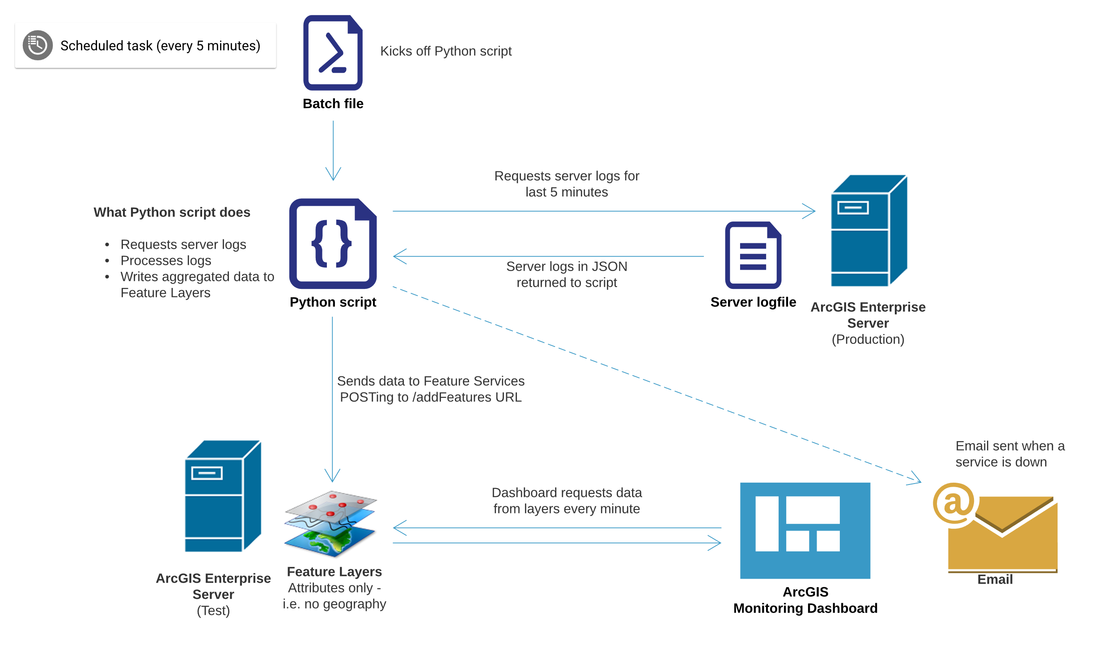
How does it all work?

Slide 8
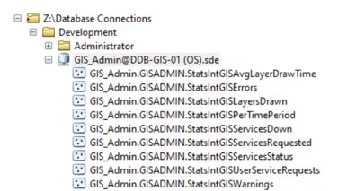
Python script
Feature classes/layers
~600 lines of code
Sends web request to query the logs
Sorts server logs by time
Filters & aggregates log messages
POSTs time-based data to each feature layer URL in turn
Sends email if any services are down
Set feature layers to refresh automatically every minute

Slide 9
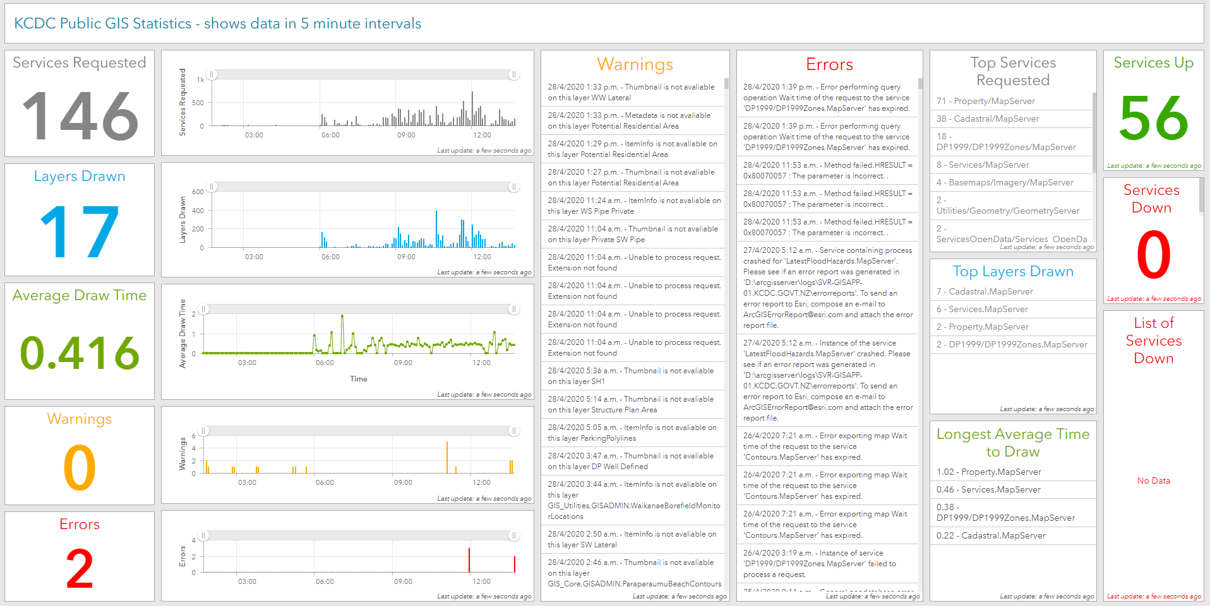
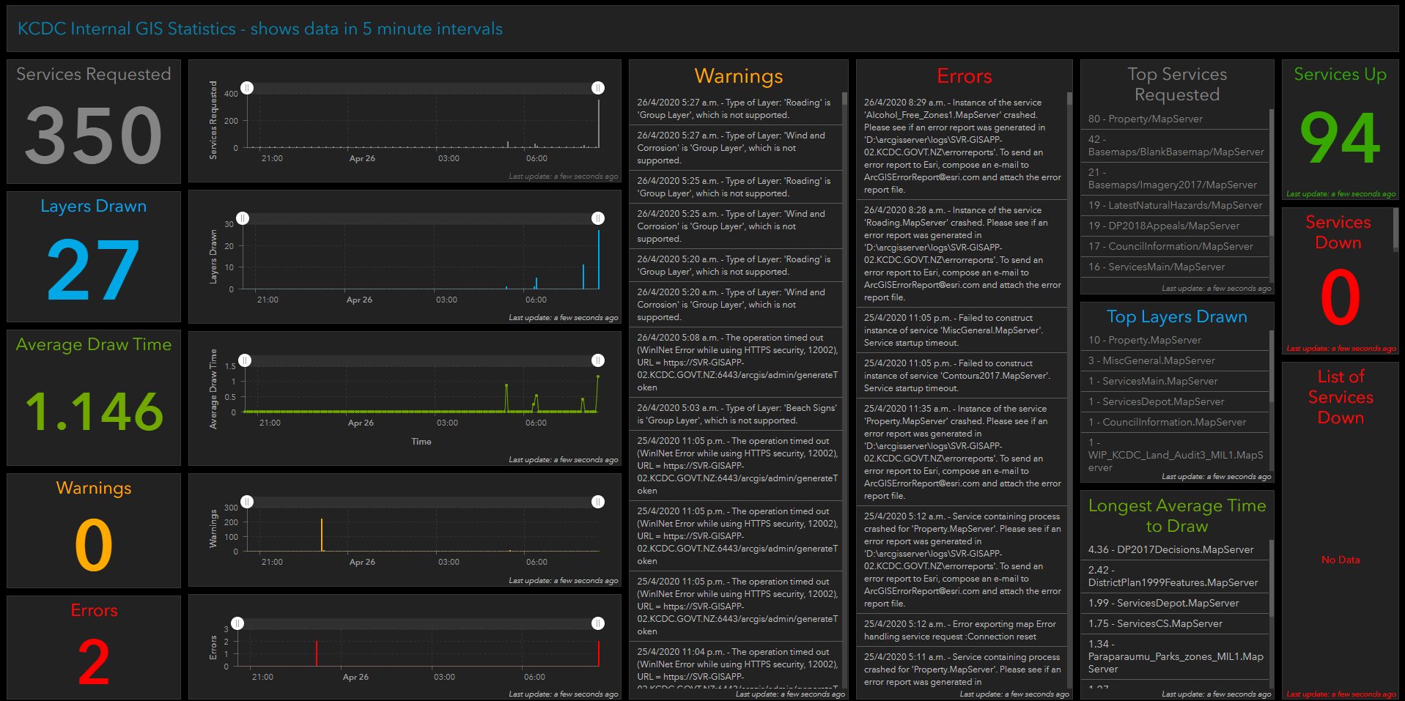
How we use the dashboards
Dashboard for Public GIS
Dashboard for Internal GIS
Both dashboards use same Python script
Different feature classes, batch files, scheduled tasks

Slide 10
Gotchas
Have to use feature services rather than data tables
even though no geographic component to dashboard data
Dashboards time out after 25 or 30 mins
quick and dirty fix
<meta http-equiv="refresh" content="1200">
Get feature class definitions right first, then add to dashboard
making changes after can cause problems

Slide 11
Contact me
keith.miller@kapiticoast.govt.nz

